Slide 1

PROJECT PRESENTATION
DIABETES PREDICTION USING PYTHON
PRSENTED BY,
HARSHINI SA

Slide 2
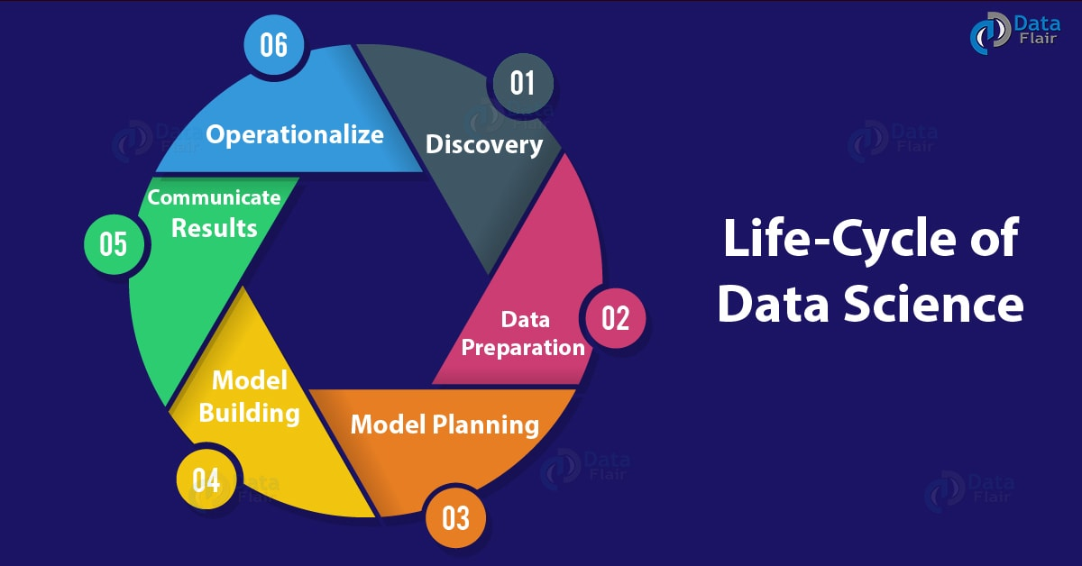

Slide 3
DIABETES MELLITUS:
Diabetes mellitus, commonly known as diabetes, is a metabolic disease that causes high blood sugar. The hormone insulin moves sugar from the blood into your cells to be stored or used for energy. With diabetes, your body either doesn't make enough insulin or can't effectively use the insulin it does make.
In people with diabetes, blood sugar levels remain high. This may be because insulin is not being produced at all, is not made at sufficient levels, or is not as effective as it should be. The most common forms of diabetes are type 1 diabetes (5%), which is an autoimmune disorder, and type 2 diabetes (95%), which is associated with obesity. Gestational diabetes is a form of diabetes that occurs in pregnancy, and other forms of diabetes are very rare and are caused by a single gene mutation.
For many years, scientists have been searching for clues in our genetic makeup that may explain why some people are more likely to get diabetes than others are. "The Genetic Landscape of Diabetes" introduces some of the genes that have been suggested to play a role in the development of diabetes.

Slide 4
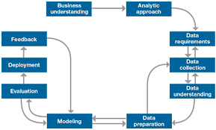

Slide 5
With the development of Data mining, researchers find that machine learning is playing an increasingly important role in diabetes research.
Machine learning techniques can find the risky factors of diabetes and reasonable threshold of physiological parameters to unearth hidden knowledge from a huge amount of diabetes-related data, which has a very important significance for diagnosis and treatment of diabetes.
So this project provides a survey of machine learning techniques that has been applied to diabetes data screening and diagnosis of the disease.
In this project, conventional machine learning techniques are described in early screening and diagnosis of diabetes.
More over deep learning techniques which have a significance of biomedical effect are also described.

Slide 6
Softwares and libraries required
Anaconda Navigator -Jupyter notebook.
Kaggle notebook for dataset-PIMA Indian diabetes dataset.
Libraries:
Pandas
Numpy
ScikitLearn.
Seaborn.

Slide 7
Procedure of Proposed Methodology:
Step1: Import required libraries, Import diabetes dataset.
Step2: Pre-process data to remove missing data.
Step3: Perform percentage split of 80% to divide dataset as Training set and 20% to Test set.
Step4: Select the machine learning algorithm i.e. K- Nearest Neighbor, Support Vector Machine, Decision Tree, Logistic regression, Random Forest and Gradient boosting algorithm.
Step5: Build the classifier model for the mentioned ma- chine learning algorithm based on training set.
Step6: Test the Classifier model for the mentioned ma- chine learning algorithm based on test set.
Step7: Perform Comparison Evaluation of the experimental performance results obtained for each classifier.
Step8: After analyzing based on various measures conclude the best performing algorithm.

Slide 8
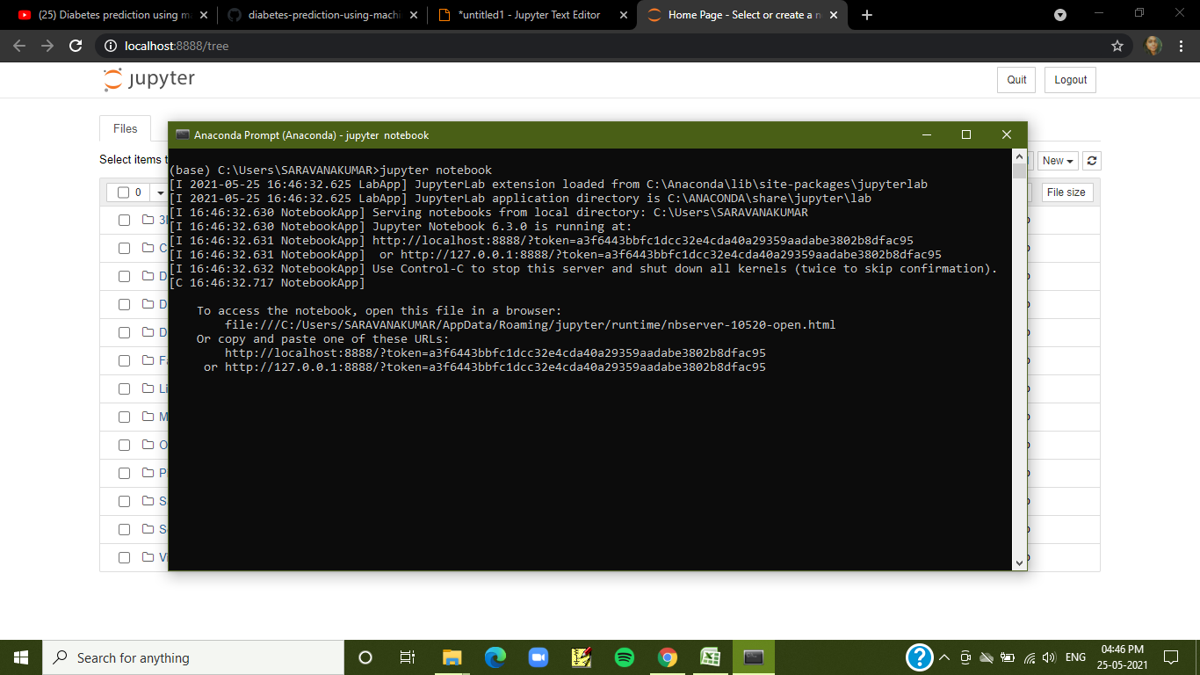
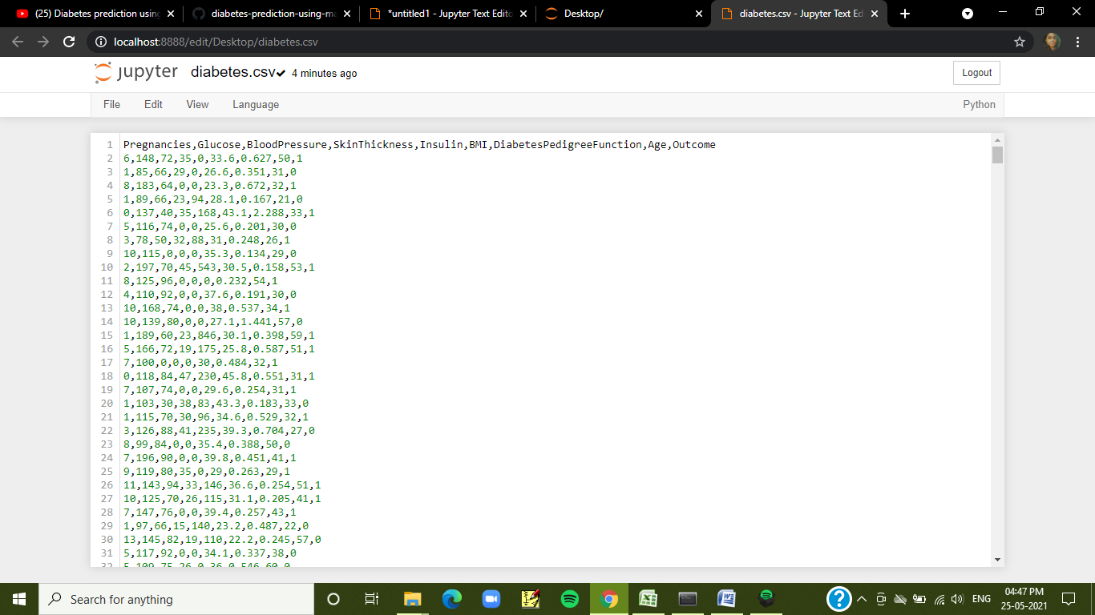

Slide 9
The main aim of this project was to design and implement Diabetes Prediction Using Machine Learning Methods and Performance Analysis of that methods and it has been achieved successfully.
I HARSHINI SA of St.Joseph’s Institute of technology has completed my project in exposys data labs on data science. I thank exposys data labs for giving this wonderful opportunity.
THANKYOU

